Slide 1
College Bound, But College Ready?

Slide 2
About AFBHS
  Comprehensive DBT Program
  Accredited
DBT Groups
  Men, Women
  Adolescents, Tweens, Kids
  Family Matters
Other Services
  Ages 4 +
  Individual, groups, marriage, family
  Variety of mental health issue

Slide 3

College Bound,
But College Ready?
What you can expect?
  Discussion about college readiness.
  Is you teen emotionally prepared?
  Is your teen socially prepared?
  Is your teen academically prepared?
  Learn ways to help your teen prepare.
  What to do if your teen is still not prepared in time?
Do Better, Be Better, Think Better

Slide 4
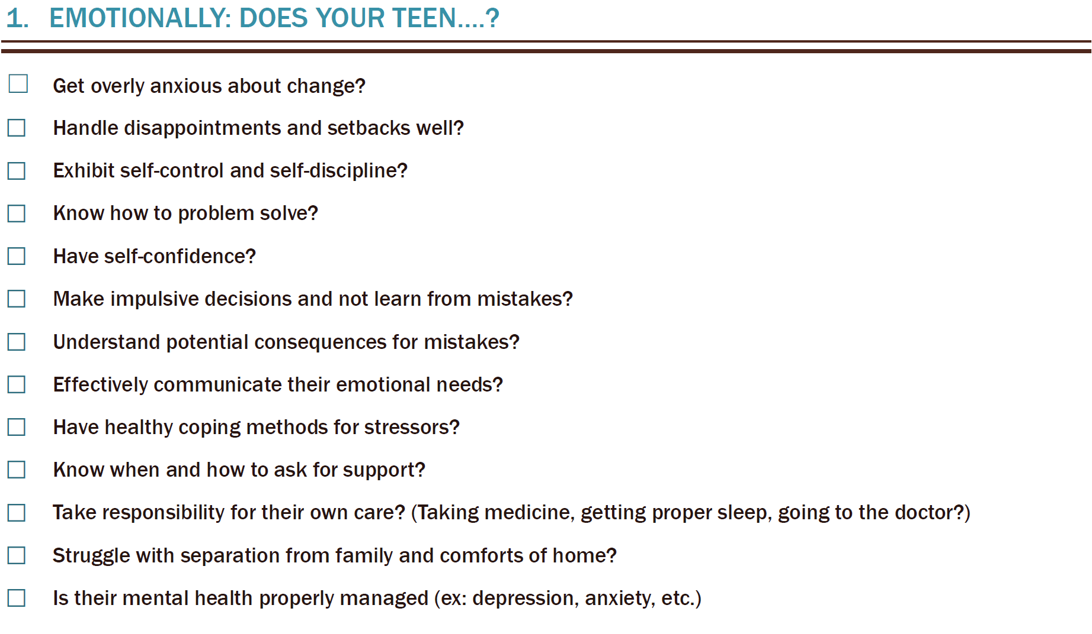


Slide 5
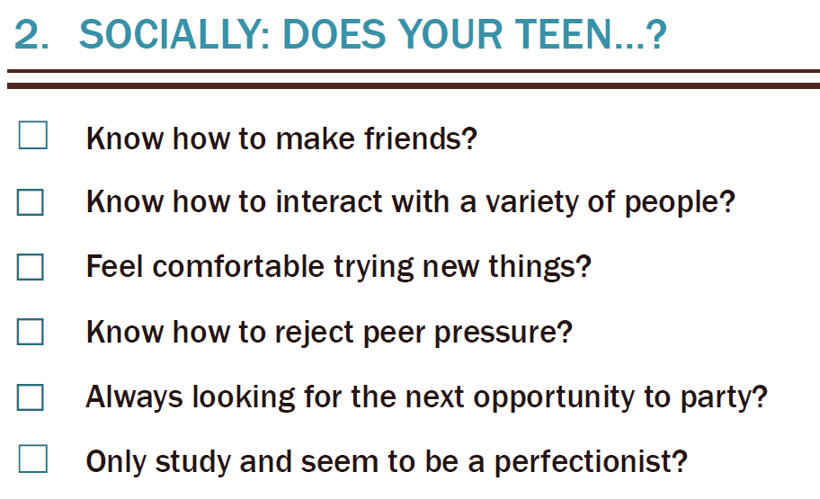


Slide 6

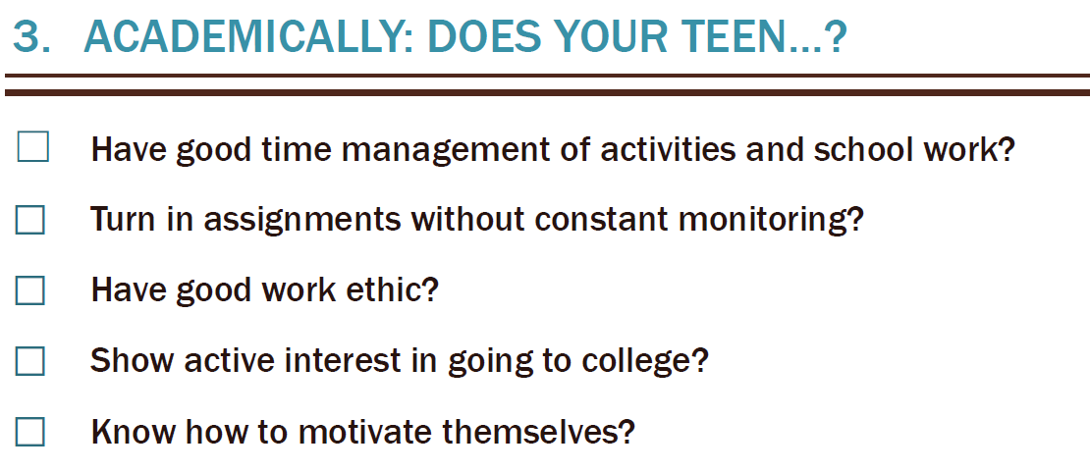

Slide 7

What to do if your teen is still not prepared in time.

Slide 8

LEARN MORE ABOUT OUR SERVICES
Adolescent & Family Behavioral Health Services
2566 Woodmeadow Dr SE,
Grand Rapids, MI 49546
www.AdolescentFamilyBHS.com
AFBHS@COMCAST.NET
(616) 719-0194
Sign up for our monthly newsletter here or at our website: http://madmimi.com/signups/13361/join

