Slide 1
Suicide Awareness & Prevention
Valencia Agnew, PhD, DBTC

Slide 2

About Us
Adolescent & Family Behavioral Health Services
  Dr. Valencia Agnew
  (616) 719-0194, www.AdolescentFamilyBHS.com, AFBHS@comcast.net
Psychologists, Social Workers, Licensed Professional Counselors
One of two with Comprehensive DBT Program
Only Accredited Program in Michigan
Multiple Awards and Recognitions
Only Family Matters Program
DBT Groups – Men, Women, Adolescents, Tweens, Kids
Couples Communication Skills Groups

Slide 3
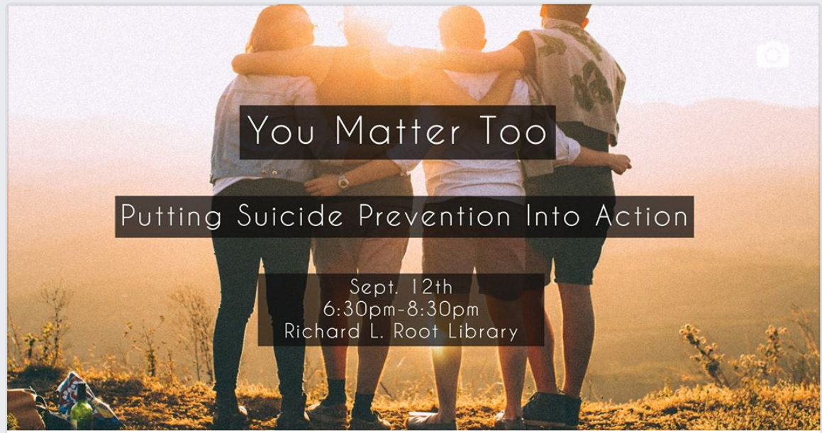
Get FREE tickets at EventBrite.com – enter You Matter Too
Notes:
Go to EVENTBRITE.COM and type in event YOU MATTER TOO

Slide 4
Objectives
Test your knowledge
Learn stats regarding suicide
Identify risk factors and warning signs of suicide
Learn things to say to someone you believe may be suicidal
Walk away with prevention resources

Slide 5

Test Your Knowledge

Slide 6
Which of the following best describes gender differences in youth suicidal behavior?
a. Boys make more suicide attempts but girls are more likely to die by suicide.
b. Girls make more suicide attempts but boys are more likely to die by suicide. Females attempt suicide three times more often than males. While males are 4 times more likely than females to die by suicide.
c. Boys and girls are equally likely to attempt suicide but boys are more likely to die by suicide.
d. Boys and girls are equally likely to attempt suicide but girls are more likely to die by suicide

Slide 7
The racial/ethnic groups having the highest rates of youth suicide are:
a. Black and Hispanic
b. White and Asian
c. American Indian and Alaskan Native
d. White and Hispanic

Slide 8
4A. Suicides happen most often:
Around Thanksgiving and Christmas
Holidays in general
In the winter when there is less sunlight
In the spring

Slide 9
4. Most suicides are the fatal outcome of:
a. Negative life events
b. Inherited characteristics
c. Vulnerability to stress
d. Mental health disorders

Slide 10
A “cluster” of teen suicides in a particular community or area is most likely to be a result of:
a. High unemployment
b. Lack of parental supervision
c. Exposure to suicide or contagion
d. All of the above

Slide 11
15. Approximately what percent of depressed teens receive some form of treatment?
a. 10%
b. 30%
c. 50%
d. 80%

Slide 12
Which statement about teen suicide is not true?
Most occur after school hours.
Most occur in the child’s home.
Most are precipitated by interpersonal conflicts.
Most are accidental.

Slide 13
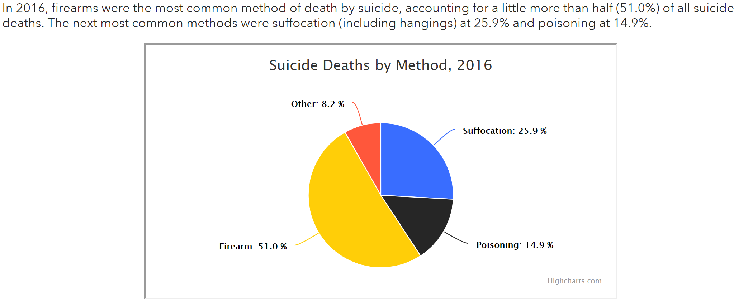
Suicide Methods

Slide 14
STATISTICS

Slide 15
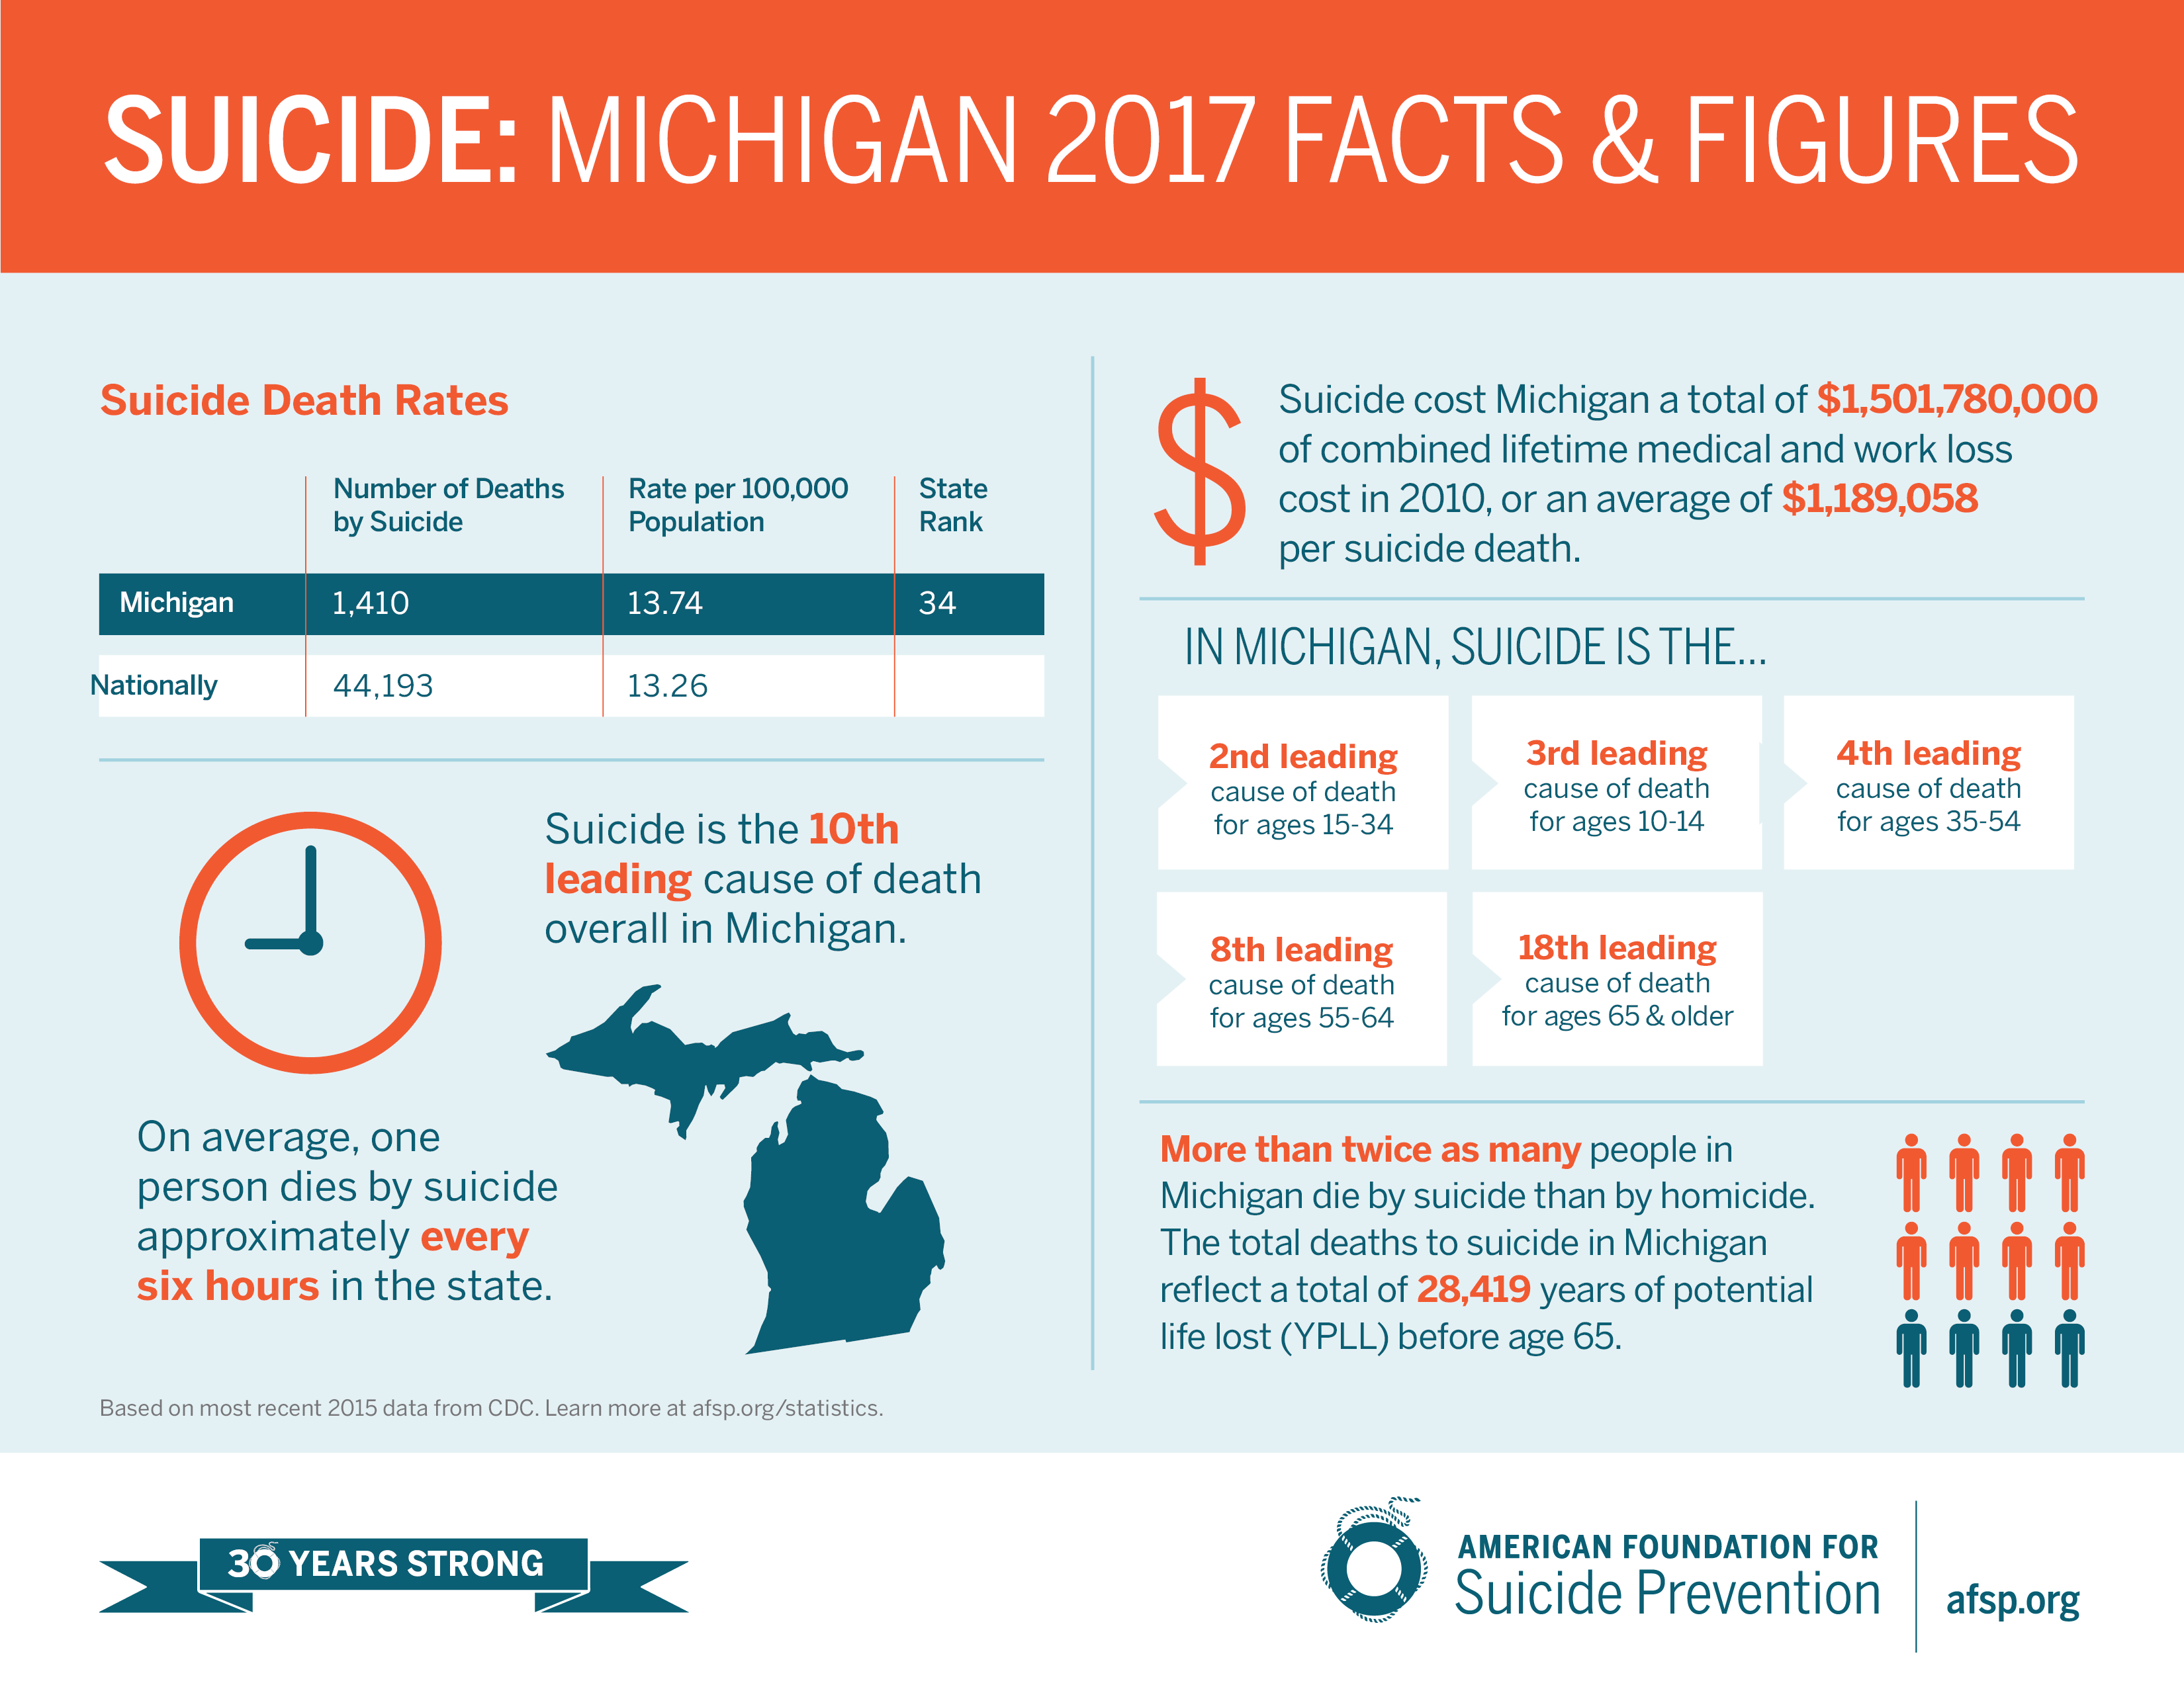
Notes:
All Causes of Death
1.Heart Disease
2.Cancer
3.Unintentional Injuries
4.Chronic Lower Respiratory Diseases
5.Stroke
6.Alzheimer's Disease
7.Diabetes Mellitus
8.Kidney Disease
9.Pneumonia/Influenza
10.Intentional Self-harm (Suicide)

Slide 16

Prevalence of Suicide in Young African Americans
https://youtu.be/5h7tMNfyYog - Video
5- to 12-year-olds suicide rates in African American children is double that of White children.
For older children, the trend reverses back to the national average. For youth aged 13-17 years, suicide was roughly 50 percent lower in African American children than in white children. JAMA Pediatrics. 2018 May 21
Notes:
Stigma in the AA community and in general

Slide 17
RISK FACTORS
WARNING SIGNS
PROTECTIVE FACTORS

Slide 18
What leads to suicide?
Suicide most often occurs when stressors exceed current coping abilities of someone suffering from a mental health condition.
Depression is the most common condition associated with suicide, and it is often undiagnosed or untreated.
Conditions like depression, anxiety and substance problems, especially when unaddressed, increase risk for suicide.

Slide 19
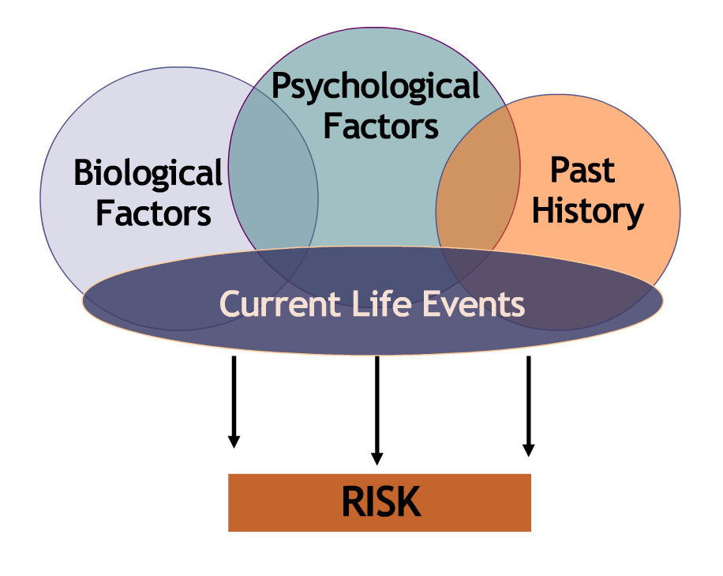
Risk factors are characteristics or conditions that increase the chance that a person may try to take their life and endure over a period of time
Health/
Environmental
Notes:
But focusing solely on mental health conditions does not give us a full picture of the complexities of suicide risk.
Suicide risk almost always starts with the underlying layers of:
-biological factors (including genetics and biological predispositions to mental illness)
-psychological factors (such as traits like perfectionism, ways of perceiving self and interpreting events, actions of others)
-past history (death of a loved one, history of abuse, family history of health problems)
Then add the current life issues and events such as stresses at home, school and with peer relationships. These factors can come together to lead to hopelessness. Add traits of aggression, impulsivity and access to means, and you have a high risk situation.
To the outside person or to the media, it can be very difficult to even see the underlying risk factors.
But the human mind seeks answers and closure, and we think (appropriately) in terms of cause and effect.
So in most cases, a suicidal act or completed suicide is attributed primarily to external factors with only glimpses of the more invisible but critical issues.
Anguish and despair are extremely private, internal experiences. What gets expressed outwardly is highly variable, with some individuals wearing their emotions on their sleeve, and others keeping emotions fairly hidden from view. This is the reason paying attention to even subtle but distinct behavioral changes that represent a departure from the person’s “usual self” is part of the education involved in suicide prevention.
And this is a way to understand the common misunderstanding about suicide being caused by a single event or loss, or the main focus being on external events.

Slide 20
Environmental Factors
Stressful life events which may include a death, divorce, or job loss, break ups, loss of any nature
Prolonged stress factors which may include harassment, bullying, relationship problems, and unemployment
Access to lethal means including firearms and drugs
Exposure to another person’s suicide, or to graphic or sensationalized accounts of suicide
Health Factors
Serious or chronic health condition and/or pain

Slide 21
Historical Factors
Previous suicide attempts
Family history of suicide attempts
Suicide risk in teens is clearly linked to seven disorders
Depressive and Anxiety
Conduct Disorder
Schizophrenia and Bipolar Disorder
Eating Disorders and Substance Use Disorders

Slide 22

Bullying
Youth who report both being bullied and bullying others have the highest rates of negative mental health outcomes, including depression, anxiety, and thinking about suicide.
Youth who report being frequently bullied by others are at increased risk of suicide related behaviors, and negative physical and mental health outcomes.
Youth who report frequently bullying others are at high, long-term risk for suicide related behavior.
In youth, bullying behavior and suicide-related behavior are closely related.

Slide 23

Suicide Warning Signs
Warning Signs are the expression of the suicidal risk and signal an imminent suicide risk.
Changes in behavior or the presence of entirely new behaviors. Their typical range of behavior that lasts for a few weeks
This is of sharpest concern if the new or changed behavior is related to a painful event, loss, or change.
Most people who take their lives exhibit one or more warning signs, either through what they say or what they do.

Slide 24

Suicide Warning Signs - TALK
People will often times say certain things that will tip you off. Although they may even try to make it sound like a joke, any of the subjects listed below are mentioned, take notice:
  Killing themselves
  Having no reason to live
  Being a burden to others
  Feeling Trapped
  Unbearable pain
Often times we take this too lightly but ask yourself, “What is the harm in having a caring conversation?”
Notes:
Sometimes we will hear the warning signs in what is being said. Don’t assume they’re joking. Always start the conversation.

Slide 25

Suicide Warning Signs - BEHAVIOR
Be on alert for these behavioral changes:
Increased use of alcohol or drugs
Looking for a way to end their life, such as searching online for materials or means
Acting recklessly
Withdrawing from activities
Isolating from friends and family
Sleeping too much or too little
Visiting or calling people to say goodbye
Giving away prized possessions
Increasing violent behavior
Notes:
A person’s suicide risk is greater if a behavior is new or has increased, especially if it’s related to a painful event, loss, or change.

Slide 26

Suicide Warning Signs - MOOD
People who are considering suicide often exhibit one or more of the following moods:
Depression
Loss of interest
Rage
Irritability
Humiliation
Anxiety
Understand that when people display these behavioral changes it may often look like they want to be left alone rather than a cry for help. Further, many people would have the tendency to avoid dealing with someone in these moods but again, what harm can a caring conversation have?
Notes:
Sometimes our best indication that someone could be at risk for suicide is a sudden change in their mood. Changes that last for two weeks.

Slide 27
Protective Factors
Effective treatment for mental, physical, and substance use /abuse disorders
Easy access to clinical treatment, interventions, and support
Family and community support
Support from ongoing medical and mental health relationships
Developing of coping skills, problem solving skills, conflict resolution as a nonviolent way of handling disputes
Cultural and religious support systems
Cultural and religious beliefs that discourage suicide
Pets
Spirituality

Slide 28
PREVENTION

Slide 29
Suicide Prevention:
Call or Text the National Suicide Prevention Lifeline – both are free 24/7
  1(800)273-TALK (8255)
  Text TALK to 741741
    To talk with or text a trained crisis counselor. Not only can they help someone contemplating suicide but they can also assist those trying to help someone contemplating suicide

Slide 30
Prevention Tools
AFSP (American Foundation for Suicide Prevention –
Look Both Ways: Mental Health Awareness Month
Think about the people you come into contact with throughout the course of your day. Your family, neighbors, classmates, coworkers, and friends.
Do your part in creating a caring culture by being present, taking a moment, listening, and knowing what to look for, not just in others, but yourself.
Practice mental health safety by looking both ways – outward and inward – at others and in yourself.
Look both ways – knowledgeably and compassionately – stay aware and take action if you or the people in your community need help.
Awareness can save a life. Look both ways to stop suicide.

Slide 31
BE N.I.C.E. be nice. is more than a phrase. It's an Action Plan!
”N” stands for notice. Notice what is right and what is good about someone. Notice if something is different about the way a person is thinking, acting or feeling.
“I” stands for Invite. Invite yourself to start a conversation. Inviting involves taking a risk and reaching out.
“C” stands for Challenge. Challenge the stigma of mental health as something you don’t talk about or need to get help for.
“E” stands for Empower. Empower yourself to have an effect on how someone thinks, acts or feels.

Slide 32
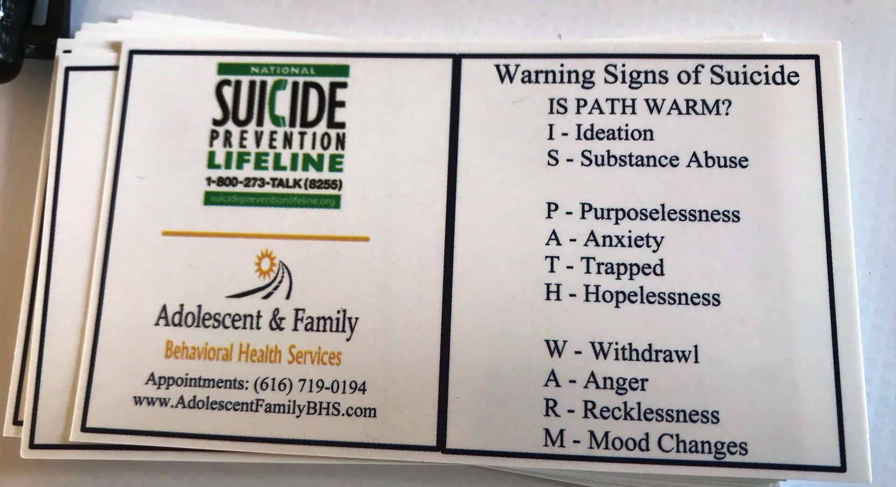
AFBHS Suicide Prevention Wallet Cards

Slide 33
Get FREE tickets at EventBrite.com – enter You Matter Too
Notes:
Go to EVENTBRITE.COM and type in event YOU MATTER TOO

Slide 34

EMAIL US AT AFBHS@COMCAST.NET
Call (616) 719-0194

